Slide 1
Introduction to Bayesian Thinking
Dr. Nilesh Patil

Slide 2
Bayesian Thinking
Bayesian Thinking is a mental model that allows you to adapt your thinking reactively to new evidence.
Bayesian thinking is a form of statistical reasoning. It involves calculating and updating probabilities as new information becomes available to make the best possible predictions.
Bayesian thinking has been successfully applied to fields outside of statistics including education, philosophy, economics and law.
This mental model works in contrast to another statistical method called frequentism which determines how frequently some event occurs within a certain time period and then predicts future events using this information.
Critical thinking is an active and ongoing process. It requires that we all think like Bayesians, updating our knowledge as new information comes in.

Slide 3
Questions?
What is Bayesian Thinking and How Does it Work?
Bayesian thinking involves using this principle to update our beliefs in light of available data or observation, taking into account both our prior beliefs and any new information that has become available.
P(observed | belief): Probability of observing the data given the belief or hypothesis is true. Different observations could result in different belief and hence P(observed | belief) will continue to change.
P(belief | observed): Probability that the belief or hypothesis holds good given the observation or data. This helps strengthening our belief about something based on the given data.

Slide 4
Bayesian
Frequentist
Prior knowledge
Updatable with new information
Data are fixed
Parameters are described probabilistically
Complex to compute
No prior information to model
Data is a repeatable random sample
Parameters are fixed
Easy to compute

Slide 5
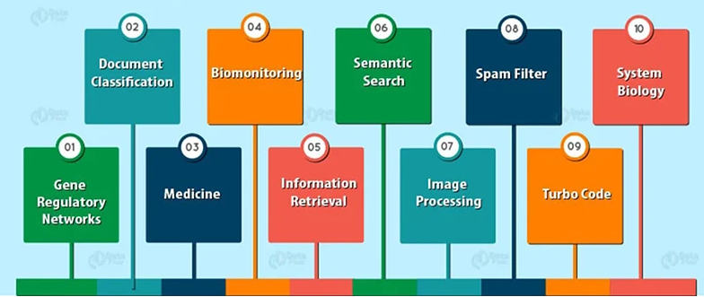
Applications of Bayesian Thinking
Notes:
1. Gene Regulatory Network
GRN is Gene Regulatory Network or Genetic Regulatory Network. It comprises of several DNA segments in a cell. It interacts with other substances in the cell and also with each other indirectly. Indirectly means through their protein and RNA expression products. Thus, it governs the expression levels of mRNA and proteins. GRNs reproduce the behaviour of the system using Mathematical models. In some cases, corresponding with experimental observations, it generates predictions.
2. Medicine
It is the science or practice of diagnosis. For the treatment and prevention of any disease, we use medicines. We are using medicines since ancient times. Over the years, medicines and drugs have evolved to cater to a variety of health care practices. In order to provide better healthcare, machines and other computer devices assist us in the diagnosis of the disease.
3. Biomonitoring
We use biomonitoring to quantify the concentration of chemicals. It measures the concentration in blood and tissue of humans, etc. Hence, it is the measurement of the body burden in analytical chemistry. Biomonitoring involves the use of indicators. These measurements are often done in blood and urine. To determine the levels of many ECCs in humans, DTSC scientist is conducting biometric studies.
4. Document Classification
It is a problem in library science, computer science, and information science. The main task is to assign a document to multiple classes. We can also do it manually or algorithmically. Manual classification is intellectual classification and it takes time. We use the algorithmic classification of documents in information science and computer science.
5. Information Retrieval
It is the activity of obtaining information resources. Information retrieval concerns retrieving the information from databases. It is a continuous process. During the process, we can consider, reconsider and refine our research problem. Metadata or full-text indexing is the basis of searching. To reduce “information overload“, we use automated information retrieval systems.
6. Semantic Search
By understanding searcher intent and the contextual meaning of terms, it improves search accuracy. It enhances the accuracy in the searchable dataspace, whether on the web or within a closed system, to generate more relevant results.
7. Image Processing
It is the processing of images by using mathematical operations. We can also use image processing to convert images into digital format. After converting the images, we can also apply some operations on it to enhance the image. Image processing is any form of signal processing.
In this, the input can be formed as an image, such as a photograph or video frame. The output of image processing may be either a set of characteristics or parameters related to the image or an image. Hence, in image processing techniques, we generally treat the image as a two-dimensional signal. After that, we apply standard signal processing on it.
8. Spam Filter
The spam filter is a program. We use a spam filter to detect unsolicited and unwanted email. Bayesian spam filter calculates whether the message is spam or not. The Bayesian spam filter is more robust than other spam filters. We use filtering to learn from spam and ham messages.
9. Turbo Code
The turbo codes are a class of high-performance forward error correction codes. Thus, turbo code uses the Bayesian Network. Turbo codes are the state of the art of codecs. 3G and 4G mobile telephony standards use these codes. Hence the Bayesian Network represents turbo coding and decoding process.
10. System Biology
We can also use BN to infer different types of biological network from Bayesian structure learning. In this, the main output is the qualitative structure of the learned network.

Slide 6
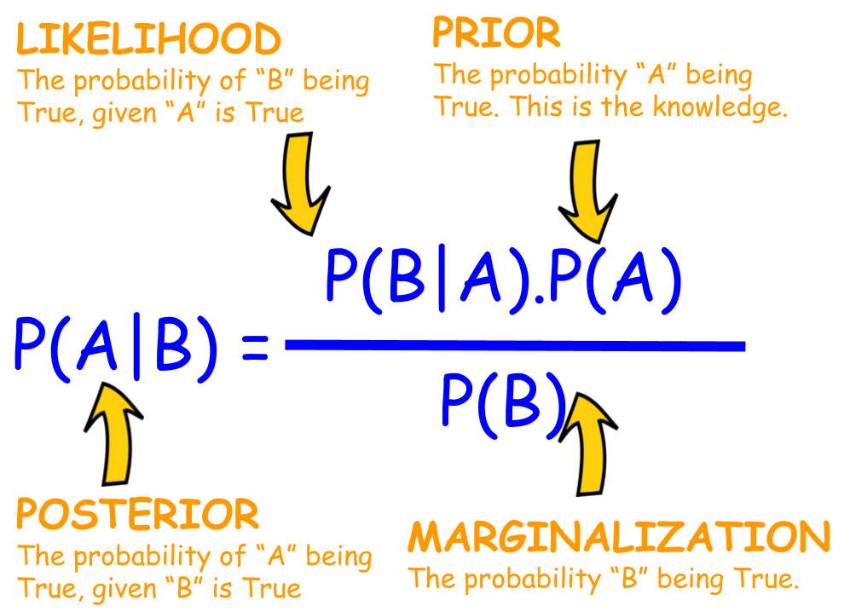
Bayes’ Theorem
Bayes’ Theorem states that: “The probability of an event happening A, given that it has happened B, is equal to the probability of the event happening B, given that it has happened A times the probability of both events occurring together divided by the sum total for all possibilities.”

Slide 7
Bayesian Statistics
Bayesian statistics mostly involves conditional probability, which is the probability of an event A given event B, and it can be calculated using the Bayes rule.
The concept of conditional probability is widely used in medical testing, in which false positives and false negatives may occur.
A false positive is an outcome where the model incorrectly predicts the positive class. And a false negative is an outcome where the model incorrectly predicts the negative class.
Example: The patient may be diagnosed with diabetes when they actually do not have the disease. This is a false positive. This can lead to unnecessary medical treatment. On the other hand a false negative is when the test shows that a patient does not have diabetes when they actually do.

Slide 8
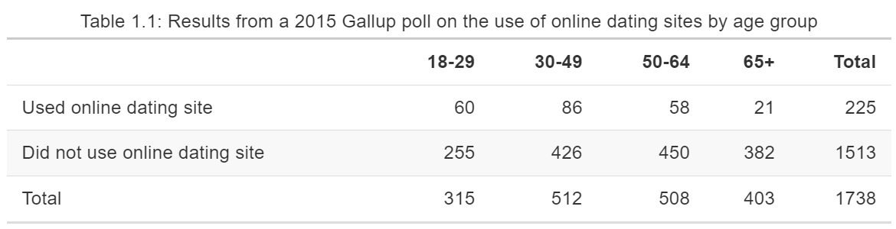
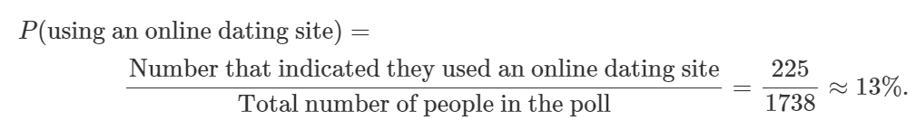
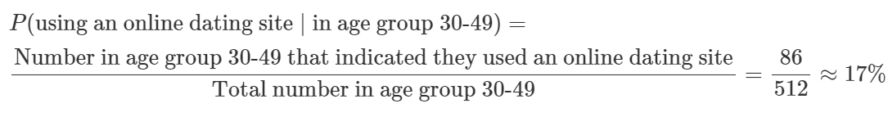
Consider the table 1.1 that shows the results of a poll among 1,738 adult Americans.
1. What is the probability of an adult American using an online dating site?
2. What is the probability of using an online dating site if one falls in the age group 30-49?

Slide 9
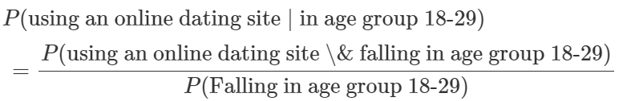
3. What is the probability that an 18-29 year old from Table 1.1 uses online dating sites?

Slide 10
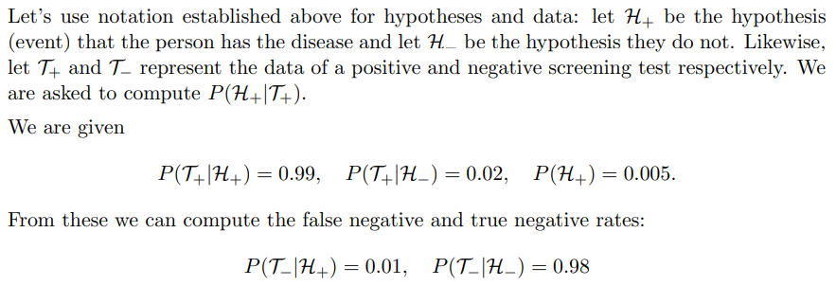
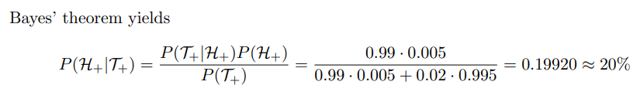
A screening test for a disease is both sensitive and specific. By that we mean it is usually positive when testing a person with the disease and usually negative when testing someone without the disease. Let’s assume the true positive rate is 99% and the false positive rate is 2%. Suppose the prevalence of the disease in the general population is 0.5%. If a random person tests positive, what is the probability that they have the disease?

Slide 11
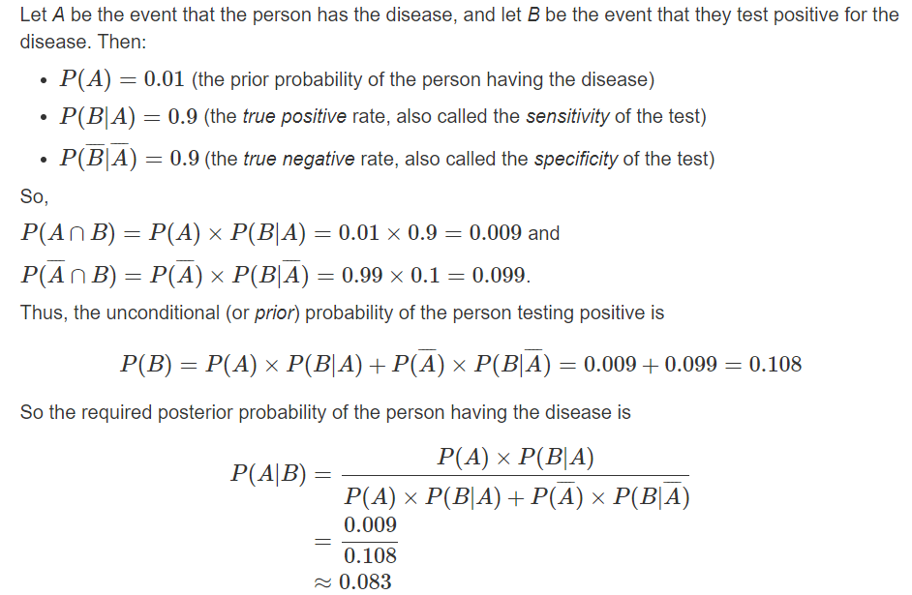
The incidence of a disease in the population is 1%. A medical test for the disease is 90% accurate in the sense that it produces a false reading 10% of the time, both: (a) when the test is applied to a person with the disease; and (b) when the test is applied to a person without the disease. A person is randomly selected from population and given the test. The test result is positive (i.e. it indicates that the person has the disease). What is the probability that the person actually has the disease?

Slide 12
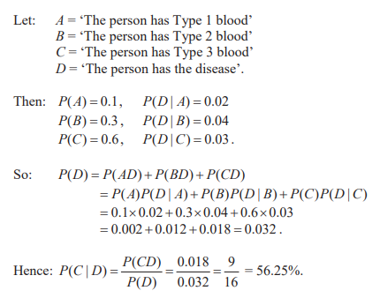
In a particular population: 10% of persons have Type 1 blood, and of these, 2% have a particular disease;
30% of persons have Type 2 blood, and of these, 4% have the disease;
60% of persons have Type 3 blood, and of these, 3% have the disease.
A person is randomly selected from the population and found to have the disease. What is the probability that this person has Type 3 blood?

Slide 13
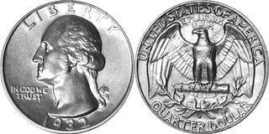
Coin Flip Example
10
4
In order to explain Bayes principle, we conducted a very small experiment: we tossed a coin 14 times.
We obtained 10 heads and 4 tails.
Let’s say we wish to know the probability of getting two heads in a row on our next two tosses.
Notes:
In order to explain Bayes principle, we conducted a very small experiment: we tossed a coin 14 times.
We obtained 10 heads and 4 tails.
Let’s say we wish to know the probability of getting two heads in a row on our next two tosses.

Slide 14
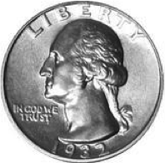
Frequentist Approach
The frequentist approach says that the probability of the next toss being head is 10/14 = 0.714
10/14
= 0.714
Probability of 1 head next:
So for 2 toss, you will assume that the 2 toss are not linked ( independently, binomially distributed ), and simply square 0.71 to obtain 0.51.
0.714
X
0.714
= 0.51
Probability of 2 heads next:
This result suggests that there is a bit more than half a chance to get a head, so we WOULD BET on it.
Notes:
the frequentist approach says that the probability of the next toss being head is 10/14 = 0.714
So for 2 toss, you will assume that the 2 toss are not linked ( independently, binomially distributed ), and simply square 0.71 to obtain 0.51.
This result suggests that there is a bit more than half a chance to get a head, so we WOULD BET on it.

Slide 15
Bayesian Test of the Fairness of a Coin
Bayesian test of the fairness of a coin involves using Bayesian statistics to assess whether a coin is fair (has a probability of 0.5 for heads and 0.5 for tails) based on observed coin flip data. This test allows you to update your beliefs about the fairness of the coin as you gather more data.
Here's how you can conduct a Bayesian test for the fairness of a coin:
Prior Distribution: Start with a prior distribution that reflects your initial beliefs about the fairness of the coin. A common choice is a Beta distribution, which is conjugate to the binomial distribution (used for modeling coin flips). The Beta distribution has two parameters, often denoted as α and β, which can be interpreted as prior observations of heads and tails, respectively.
Likelihood Function: The likelihood function models the likelihood of the observed data given a specific parameter value (probability of heads). For coin flips, this is usually a binomial distribution.
Posterior Distribution: Using Bayes' theorem, update the prior distribution with the observed data to obtain the posterior distribution. The posterior distribution is a Beta distribution with updated parameters based on the prior and the likelihood.
Updating with New Data: As you perform more coin flips and gather new data, you can update the posterior distribution using the same process. Each time you update, your posterior beliefs become your new prior beliefs for the next update.
Decision or Inference: You can make decisions or inferences based on the posterior distribution. For example, you can compute credible intervals for the fairness of the coin or perform hypothesis tests to determine whether the coin is likely to be fair or biased.
Steps 1 through 4 involve repeated Bayesian updating. The initial prior beliefs will become less important as more data is gathered, and the posterior distribution will converge towards a more accurate representation of the coin's fairness.

Slide 16
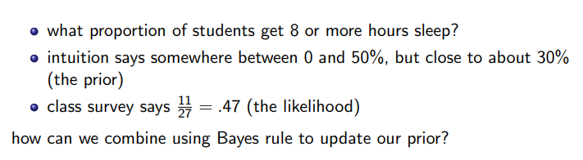
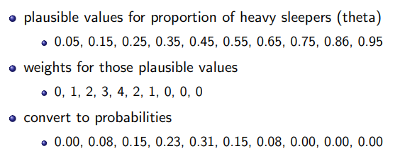
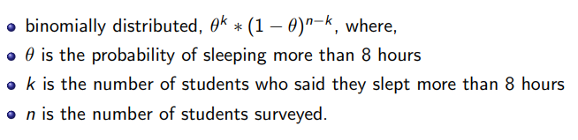

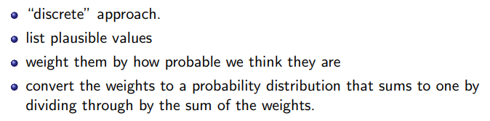
Learning about the Proportion of Heavy Sleepers
Creating the discrete prior:
The likelihood:
calculating the posterior:
The prior:

Slide 17
Discrete Prior
A discrete prior is a prior distribution that assigns probabilities to a set of discrete values.
It is often used when the parameter being estimated is discrete in nature.
For example, consider estimating the success probability of a biased coin. If you have prior information that the coin is more likely to be fair, you could use a discrete prior that assigns higher probabilities to values near 0.5.

Slide 18
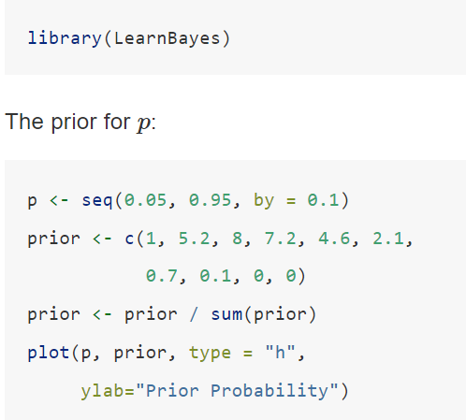
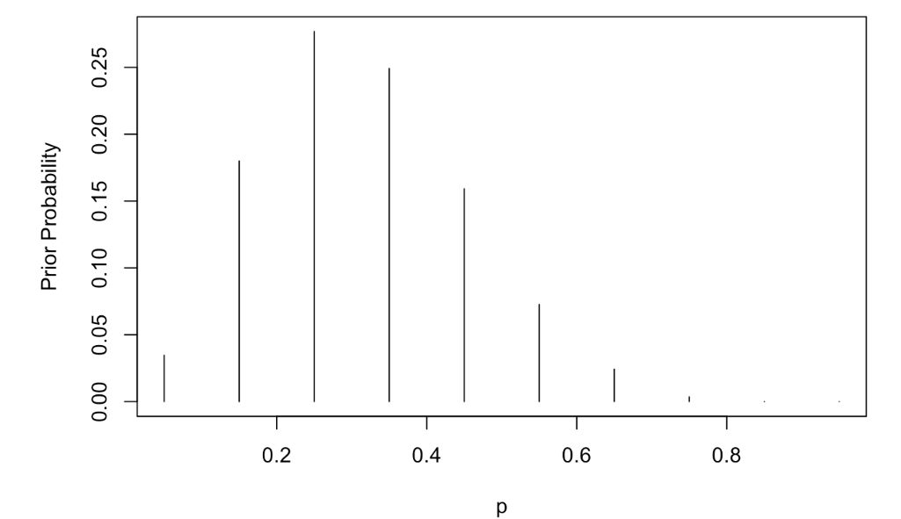

Using a Discrete Prior

Slide 19
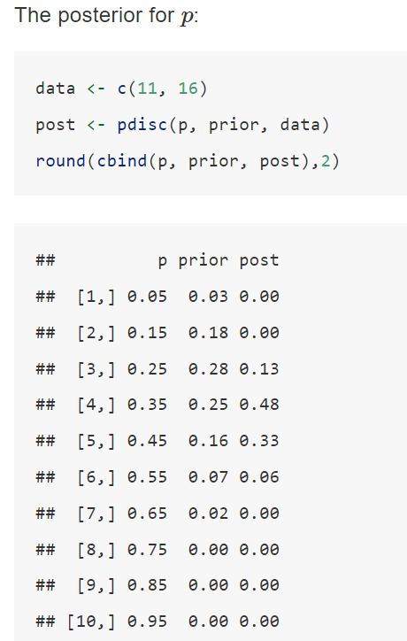
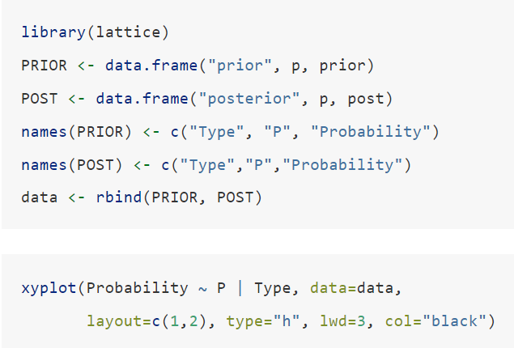
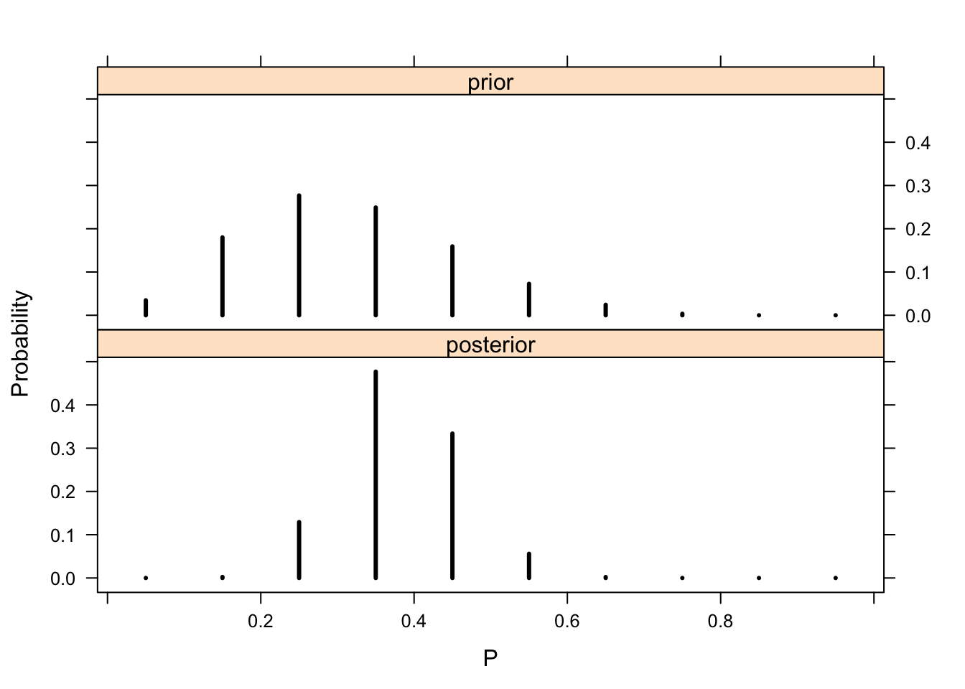

Slide 20
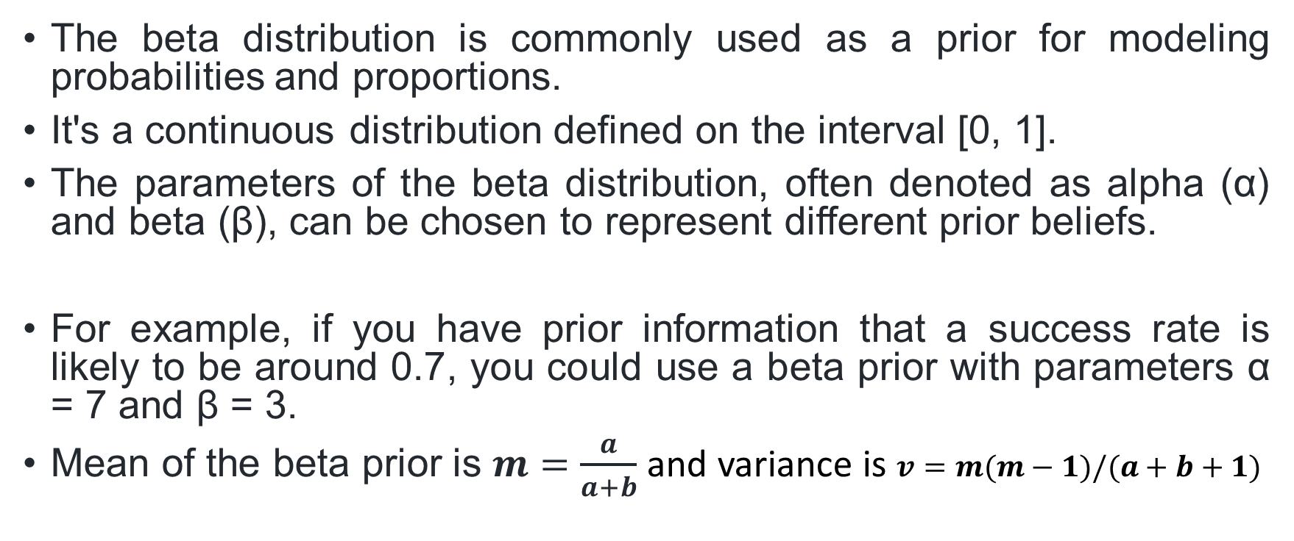
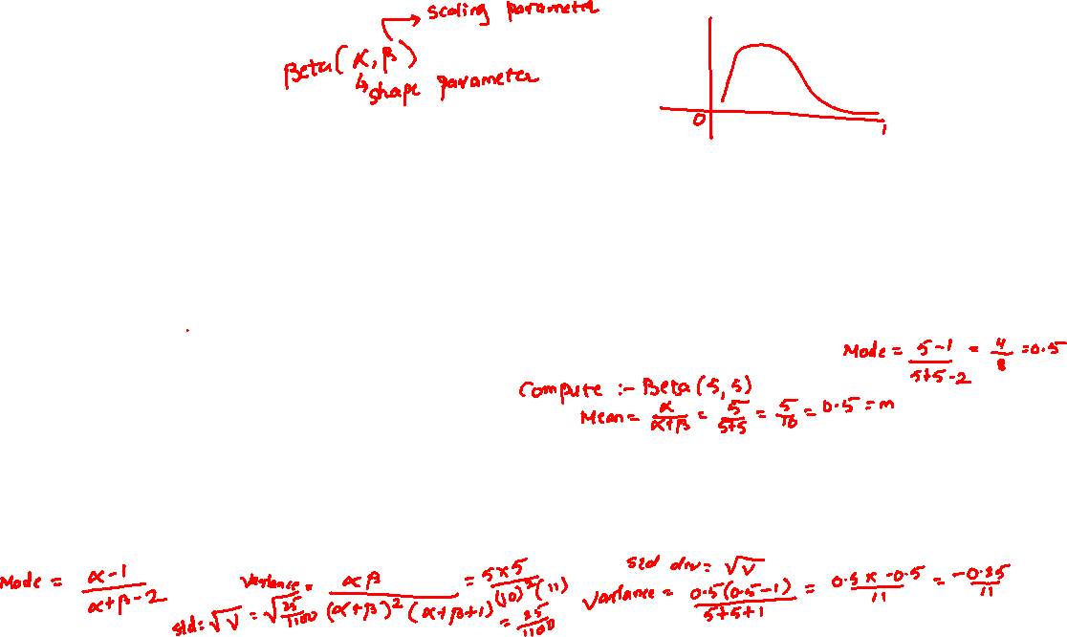
Beta Prior
The beta distribution is commonly used as a prior for modeling probabilities and proportions.
It's a continuous distribution defined on the interval [0, 1].
The parameters of the beta distribution, often denoted as alpha (α) and beta (β), can be chosen to represent different prior beliefs.
For example, if you have prior information that a success rate is likely to be around 0.7, you could use a beta prior with parameters α = 7 and β = 3.
Mean of the beta prior is $m=\frac{a}{a+b}$ and variance is $v=m(m−1)/(a+b+1)$

Slide 21
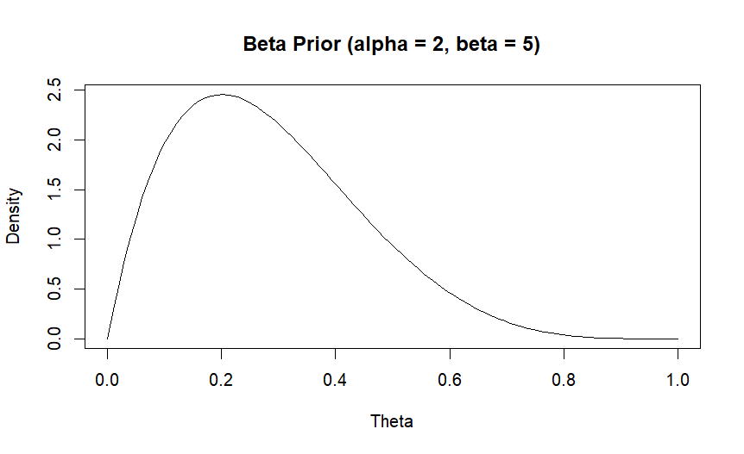
# Define a Beta prior
alpha <- 2
beta <- 5
# Create a sequence of theta values
theta <- seq(0, 1, length = 100)
# Calculate the density of the Beta distribution
beta_prior <- dbeta(theta, alpha, beta)
# Plot the Beta prior
plot(theta, beta_prior, type = "l", xlab = "Theta", ylab = "Density",
main = "Beta Prior (alpha = 2, beta = 5)")

Slide 22

Histogram Prior
A histogram prior involves using a histogram-like representation of the prior distribution.
Instead of specifying a mathematical formula for the prior, you provide a discrete distribution represented by a histogram.
This approach can be useful when you have some rough information about the distribution of the parameter but don't want to assume a specific functional form.

Slide 23

Example
Let's consider a scenario where you are estimating the click-through rate (CTR) of an online advertisement campaign. You have the following prior information:
You believe that the CTR is likely to be around 0.3, but you're uncertain.
You've collected some historical data on CTRs from similar campaigns.
You could use a Bayesian approach with the following priors:
Discrete Prior: Assign higher probabilities to values around 0.3, indicating your belief that the CTR is likely centered around that value.
Beta Prior: Use a beta distribution with parameters α = 3 and β = 7, reflecting your belief that the CTR is likely to be in the range of 0.2 to 0.4.
Histogram Prior: Create a histogram based on the historical CTR data you've collected. This histogram would represent your prior beliefs about the possible values of CTR based on past experience.

Slide 24
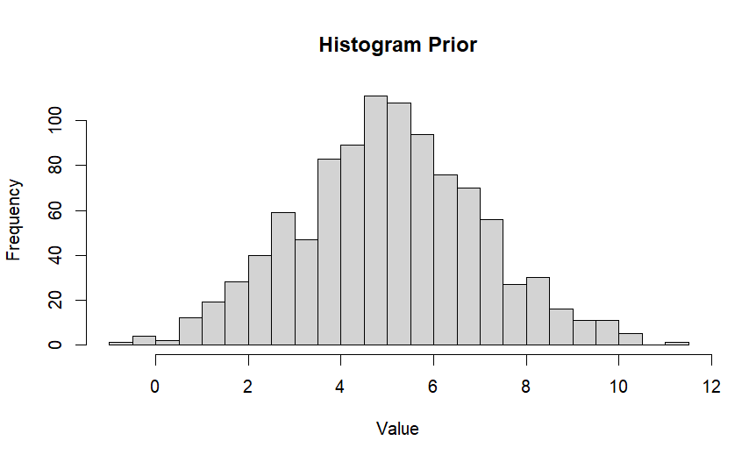
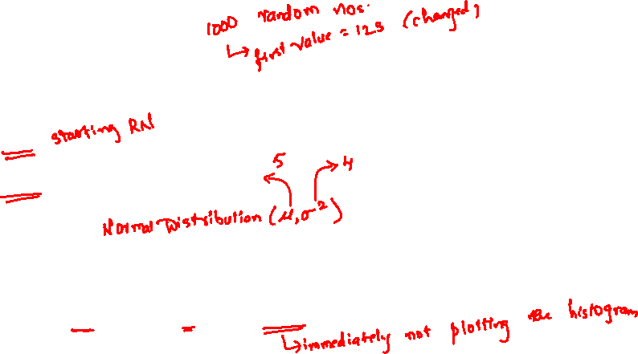
# Histogram Prior
# Generate some sample data
set.seed(123)
data <- rnorm(1000, mean = 5, sd = 2)
# Create a histogram prior
hist_prior <- hist(data, breaks = 20, plot = FALSE)
# Plot the histogram prior
plot(hist_prior, main = "Histogram Prior", xlab = "Value", ylab = "Frequency")

Slide 25
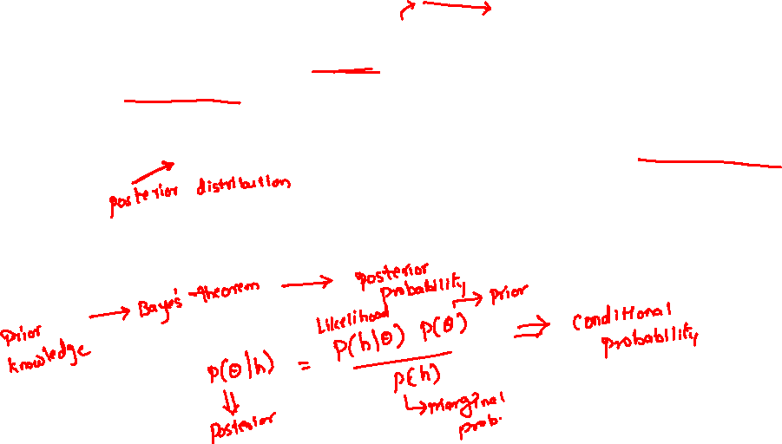
Bayesian Inference
In the Bayesian framework, we treat the unknown quantity,θ, as a random variable.
More specifically, we assume that we have some initial guess about the distribution of θ.
This distribution is called the prior distribution. After observing some data, we update the distribution of θ (based on the observed data).
This step is usually done using Bayes' Rule. That is why this approach is called the Bayesian approach.

Slide 26
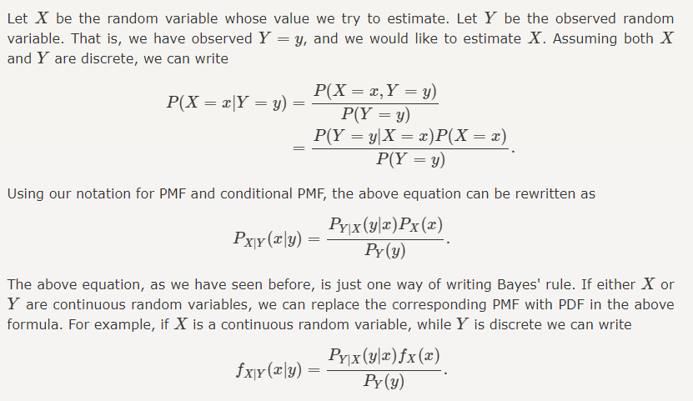
Prior and Posterior

Slide 27
Single-Parameter Models
A single-parameter model is a class of sampling distributions that is indexed by a single unknown parameter.
In various fields like statistics, machine learning, and physics, such models are often used to make simplified assumptions about complex systems.

Slide 28
Here are a few examples of single-parameter models in different contexts:
Linear Regression with One Predictor: In simple linear regression, you have a single independent variable (predictor) and one parameter (slope) that determines the relationship between the predictor and the dependent variable.
Example: y = mx + b, where m is the slope (parameter) and b is the intercept.
Exponential Growth/Decay: A common single-parameter model in population growth, finance, or radioactive decay is described by the equation:
Example: N(t) = N₀ * e^{kt}, where k is the growth/decay rate (parameter), N(t) is the population or value at time t, and N₀ is the initial value.
Logistic Growth: The logistic growth model describes population growth that approaches a limiting value. It has one parameter that represents the maximum population size.
Example: N(t) = K / (1 + e^{-rt}), where K is the carrying capacity (parameter), r is the growth rate, t is time, and N(t) is the population at time t.
Simplest Neural Network Neuron: In artificial neural networks, the simplest unit (neuron) often has just one parameter, which is the weight assigned to its input.
Example: output = activation_function(weight * input)
Statistical Distributions: Many probability distributions, such as the exponential distribution or Poisson distribution, are characterized by a single parameter. For instance, the exponential distribution has a single parameter, the rate, which determines the distribution of waiting times between events.
Example: Exponential distribution: f(x;λ) = λ * exp(-λx) where λ is the rate parameter.

Slide 29


Estimating a probability from binomial data
In the simple binomial model, the aim is to estimate an unknown population proportion from the results of a sequence of ‘Bernoulli trials’; that is, data y₁,...,y_{n}, each of which is either 0 or 1.
The binomial distribution provides a natural model for data that arise from a sequence of n exchangeable trials or draws from a large population where each trial gives rise to one of two possible outcomes, conventionally labeled ‘success’ and ‘failure.’
Because of the exchangeability, the data can be summarized by the total number of successes in the n trials, which we denote here by y.
The binomial sampling model is,
where on the left side we suppress the dependence on n because it is regarded as part of the experimental design that is considered fixed; all the probabilities are assumed to be conditional on n and the parameter θ represent the proportion of successes in the population

Slide 30
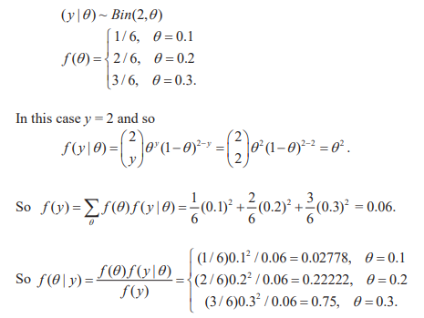
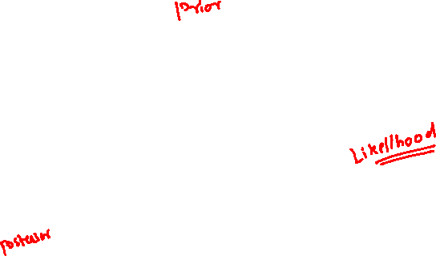
Consider six loaded dice with the following properties. Die A has probability 0.1 of coming up 6, each of Dice B and C has probability 0.2 of coming up 6, and each of Dice D, E and F has probability 0.3 of coming up 6. A die is chosen randomly from the six dice and rolled twice. On both occasions, 6 comes up. What is the posterior probability distribution of θ , the probability of 6 coming up on the chosen die.
Solution:
Let y be the number of times that 6 comes up on the two rolls of the chosen die, and let θ be the probability of 6 coming up on a single roll of that die.
Then the Bayesian model is:

Slide 31
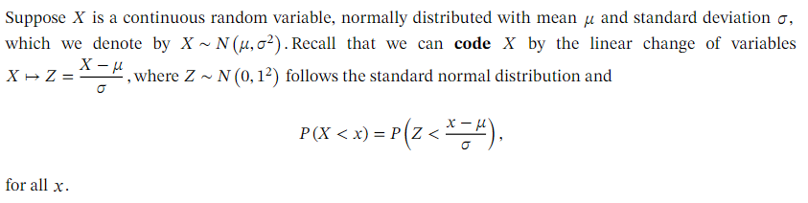
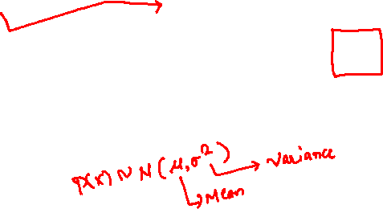
Finding Means and Standard Deviations in Normal Distributions

Slide 32
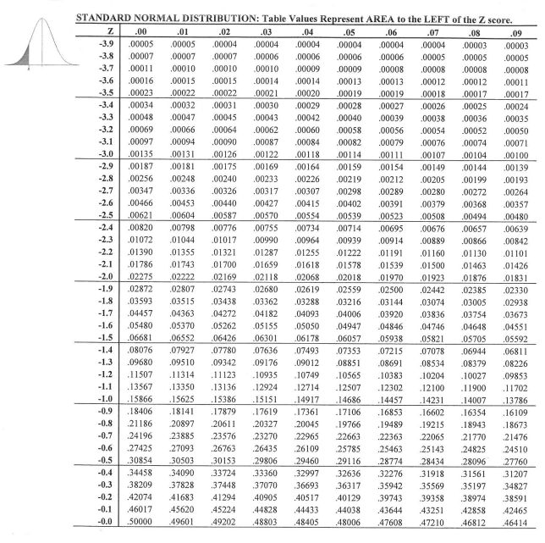
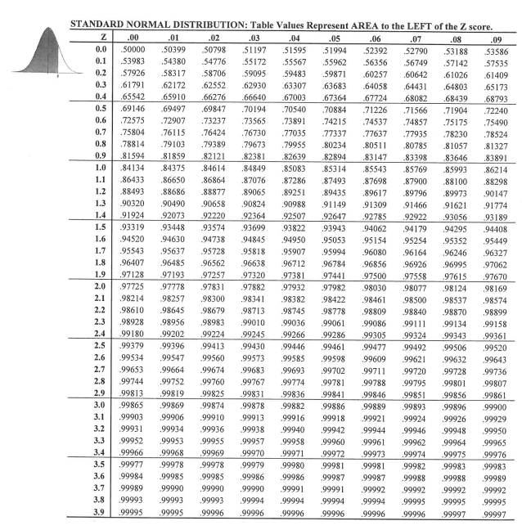



Slide 33
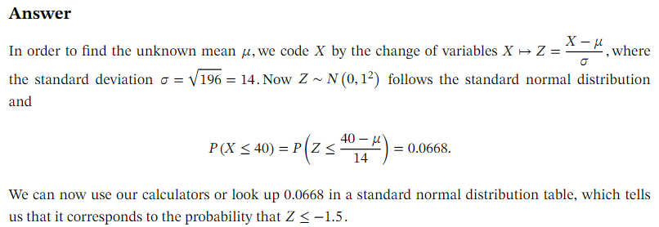
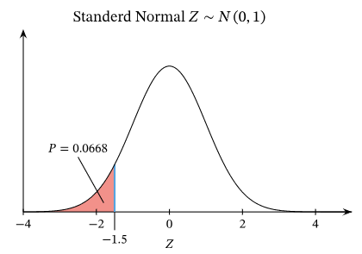
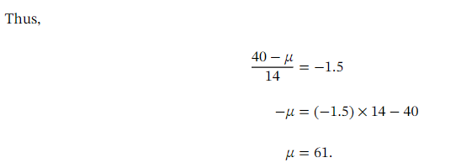
Determining the Mean of a Normal Distribution

Slide 34
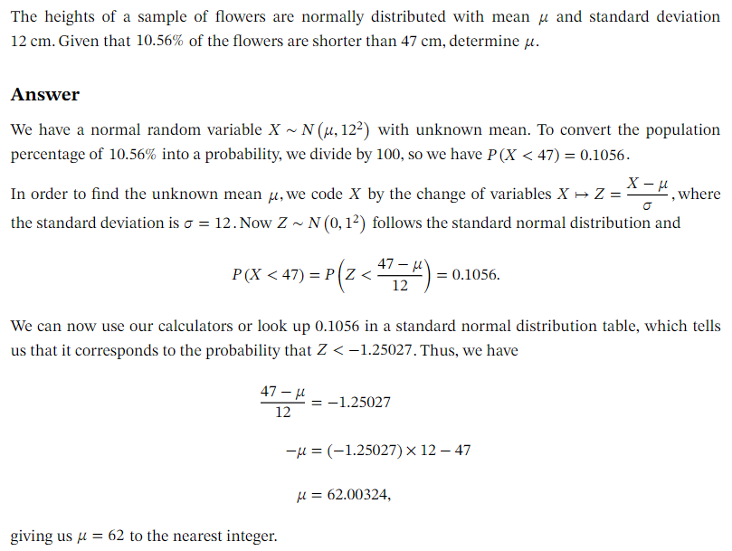
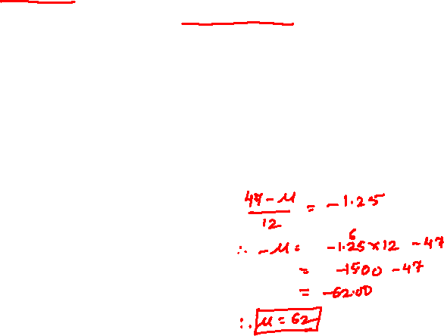

Slide 35
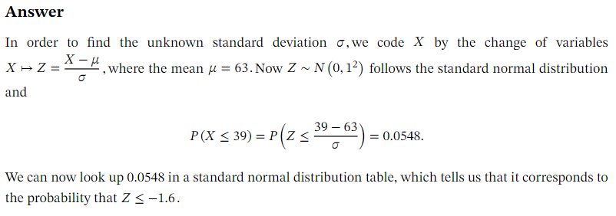
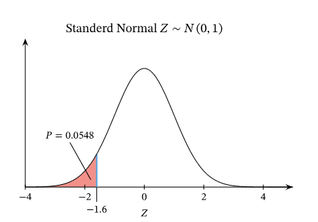
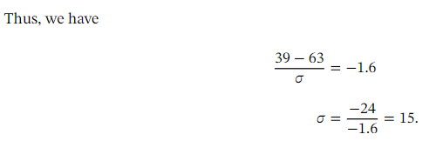
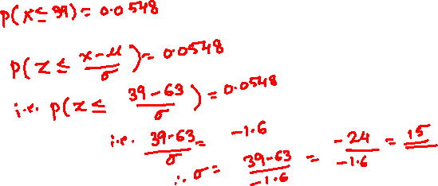
Determining the Standard Deviation of a Normal Distribution

Slide 36
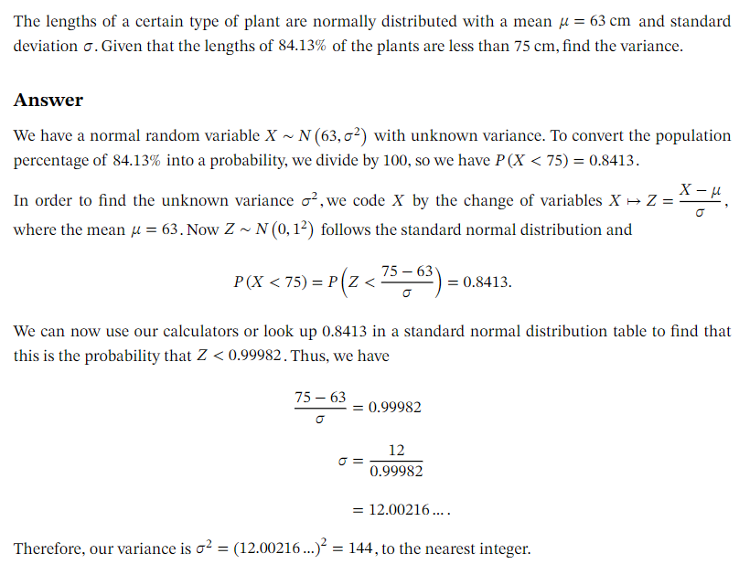
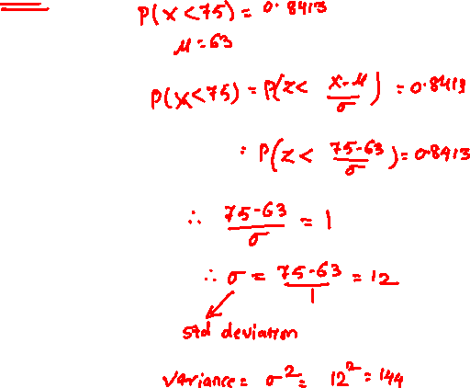

Slide 37


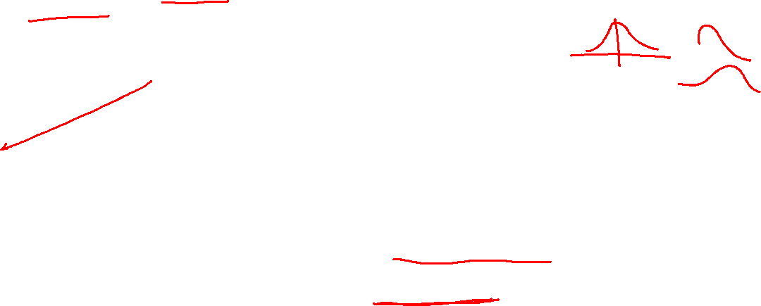
Normal distribution with known mean but unknown variance
If the population variance σ² is unknown, we can no longer use the normal distribution and instead have to use the t–distribution to calculate confidence intervals.
From this, it follows that
where Z is the standard normal distribution, i.e. Z ∼ N(0, 1). However, if the population variance is unknown, then the quantity
does not have a N(0, 1) distribution (note that the population variance σ² in Z has been replaced with the sample variance S² in T).
Instead it has a Student’s t–distribution.
This distribution is similar to the N(0, 1) distribution in that it is symmetrical and bell–shaped, but it is more heavily tailed to allow for greater uncertainty in X¯ since the true variability is now unknown.
Its exact shape is determined by one parameter called the “degrees of freedom”.

Slide 38
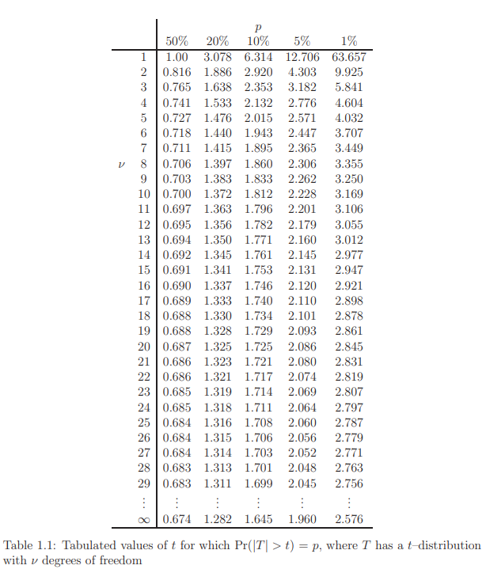
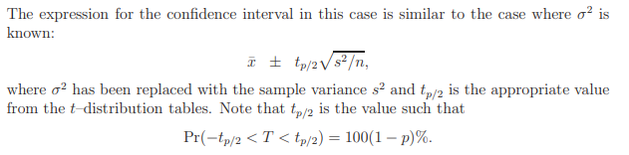
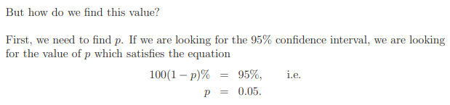
We would look up the value in the t tables in the p column, or in this case the 5% column.
We also need to know which row to look in. The rows are given as the degrees of freedom, υ, where υ = n − 1. Hence, if our sample was of size n = 10 and we were looking for the 95% confidence interval, we would look in the υ = 9 row and the p = 5% column to give us a value of 2.262 to use in our calculation.

Slide 39
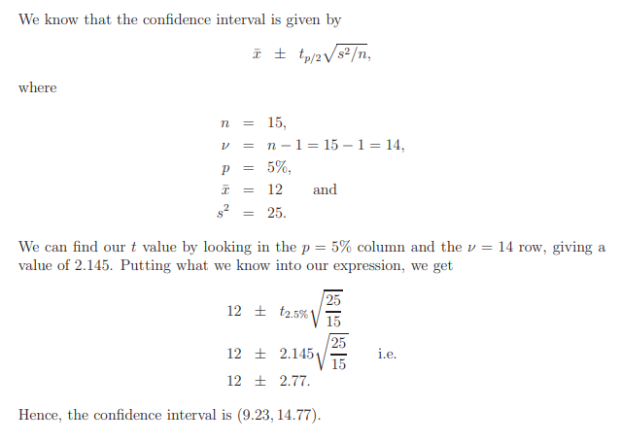

A sample of size 15 is taken from a larger population; the sample mean is calculated as 12 and the sample variance as 25. What is the 95% confidence interval for the population mean µ?

Slide 40






Slide 41
Bayesian Robustness
Bayesian robustness refers to the property of Bayesian statistical methods to provide stable and reliable inference even when the assumptions of the model are violated to some extent.
In other words, Bayesian methods are designed to handle uncertainty in model assumptions and data by incorporating prior information, which can lead to more stable and credible results compared to some frequentist methods that might be sensitive to violations of assumptions.

Slide 42
Key points about Bayesian robustness
Prior Distribution: Bayesian analysis involves specifying a prior distribution that reflects your beliefs or information about the parameters before observing the data. A strong prior can help regularize the estimates and make them more robust to outliers and deviations from assumptions.
Posterior Distribution: The Bayesian approach updates the prior beliefs with observed data to obtain the posterior distribution of the parameters. This posterior distribution takes into account both the data and the prior, allowing for a more nuanced understanding of uncertainty.
Small Sample Sizes: Bayesian methods can perform well with small sample sizes because the prior information can play a substantial role in shaping the posterior distribution, which helps stabilize the estimates.
Model Misspecification: Bayesian methods can handle certain types of model misspecification because they integrate over the uncertainty in the model space. If the true data-generating process is different from the assumed model, Bayesian methods can still provide reasonable estimates by incorporating prior information.
Robust Priors: Robust Bayesian priors are chosen to be less sensitive to extreme values or outliers. These priors help mitigate the influence of unusual observations on the parameter estimates.
Sensitivity Analysis: Bayesian robustness can be assessed through sensitivity analysis. This involves examining how the results change when different prior distributions are used or when assumptions are altered.
Hierarchical Models: Hierarchical Bayesian models are particularly useful for robust analysis. They allow for information to be borrowed from related groups or populations, leading to more stable parameter estimates.
Markov Chain Monte Carlo (MCMC): MCMC methods, commonly used in Bayesian analysis, enable the exploration of complex posterior distributions, which is useful when dealing with robustness issues.

Slide 43
Conjugate Prior
In Bayesian statistics, a conjugate prior is a type of prior distribution that, when combined with a specific likelihood function, results in a posterior distribution that has the same functional form as the prior distribution.
This leads to analytical tractability and simplifies the process of updating beliefs based on new data.
When a prior distribution is conjugate to a likelihood function, the resulting posterior distribution is also in the same family of distributions, which makes calculations much easier compared to situations where the posterior doesn't have a known analytical form.
For example, if you have a likelihood function that follows a Gaussian (normal) distribution and you choose a conjugate prior that is also a Gaussian distribution, the posterior distribution will also be a Gaussian distribution.
This property is particularly helpful in situations where you want to perform Bayesian analysis analytically rather than relying on numerical approximation methods.

Slide 44
Examples of Conjugate Priors
Normal Distribution: The conjugate prior for the mean of a normal distribution is another normal distribution. This is often referred to as a Normal-Gamma prior, where the parameters of the normal distribution are updated based on the sample mean and variance.
Poisson Distribution: The conjugate prior for the rate parameter of a Poisson distribution is the Gamma distribution.
Binomial Distribution: The conjugate prior for the probability parameter of a binomial distribution is the Beta distribution.
Exponential Distribution: The conjugate prior for the rate parameter of an exponential distribution is the Gamma distribution.

Slide 45
Mixtures of Conjugate Priors
Mixtures of conjugate priors are a concept in Bayesian statistics that involves combining multiple conjugate prior distributions to create a more flexible and versatile prior distribution for a Bayesian model.
This approach is used when the data being analyzed come from a distribution that does not have a single, well-defined conjugate prior, or when there is uncertainty about which specific conjugate prior is appropriate.
Conjugate priors are chosen for their mathematical convenience, as they lead to posterior distributions that have the same functional form as the prior.
However, in many cases, the true distribution of the data might not match any single conjugate prior distribution.
Mixtures of conjugate priors provide a way to account for this uncertainty by using a weighted combination of different conjugate priors.

Slide 46
How Mixtures of Conjugate Pairs Work?
Combining Priors: Suppose you have a Bayesian model where you need to specify a prior distribution for a parameter, but you're not sure which single conjugate prior is the best fit for your data. Instead of choosing one, you consider a mixture of several conjugate priors.
Weighting Priors: Each individual conjugate prior is assigned a weight that represents your belief in its relevance or appropriateness. The weights could be based on domain knowledge, prior experience, or other considerations.
Flexibility: By mixing conjugate priors, you allow the prior distribution to be more flexible and able to capture a wider range of possible data distributions. This can be particularly useful when dealing with complex or multi-modal data.
Posterior Calculation: When you update the prior using Bayes' theorem, the resulting posterior distribution becomes a weighted combination of the posteriors corresponding to the individual conjugate priors. This weighted combination incorporates the uncertainty about which prior distribution is the best fit for the data.
Computational Considerations: Depending on the complexity of the mixture and the number of components, the computation of the posterior distribution might involve more complex techniques, such as Markov Chain Monte Carlo (MCMC) methods, to sample from the posterior distribution.
Mixtures of conjugate priors can be particularly helpful in cases where a single conjugate prior doesn't adequately capture the underlying data distribution. By allowing for a combination of priors, you create a more robust Bayesian model that accounts for uncertainty in the choice of prior.

Slide 47
A Multinomial Model
A Multinomial model is a probability distribution model used in statistics and machine learning, particularly in contexts where you are dealing with categorical data.
It is an extension of the binomial distribution, which models the probability of success or failure in a binary event, to situations where there are more than two possible outcomes.
In the Multinomial model:
Outcome Categories: You have a discrete set of mutually exclusive and exhaustive categories or outcomes. For example, if you're modeling the outcomes of rolling a six-sided die, you have six categories (1, 2, 3, 4, 5, 6).
Probabilities: Each category has an associated probability, denoted as P(X = x), where X represents the random variable, and x represents a specific category.
Independence: The outcomes of each category are assumed to be independent of each other.
Count Data: The Multinomial distribution is often used to model count data, where you're interested in the number of occurrences of each category in a set of trials or experiments.

Slide 48

A Multinomial Model
Applications of the Multinomial model include:
Text classification: Assigning documents to predefined categories (e.g., spam detection or sentiment analysis).
Natural language processing: Modeling the frequency of words in text data.
Ecology: Analyzing species abundance in ecological surveys.
Marketing: Analyzing customer preferences for different product categories.

Slide 49

Estimating a Heart Transplant Mortality Rate
Estimating the mortality rate for heart transplants using Bayesian statistics involves incorporating prior knowledge or beliefs with observed data to produce a posterior distribution of the mortality rate.
Here’s a step-by-step guide on how you might approach this:

Slide 50



Slide 51



Slide 52


You can then compute the posterior mean, variance, and credible intervals from this Beta distribution to make inferences about the mortality rate.

Slide 53
Bioassay Experiment
In the context of a bioassay experiment, an "assay" refers to a test or procedure that measures the biological activity or effect of a substance on a living organism, tissue, cell, or enzyme.
The purpose of an assay is to evaluate the potency, concentration, or effect of the substance in question, often by observing and quantifying the biological response it elicits.
A bioassay experiment is typically conducted to determine the biological response to a substance, such as a drug, toxin, or environmental factor.
A bioassay can be either quantal or quantitative, direct or indirect.
If the measured response is binary, the assay is quantal, if not, it is quantitative.
Direct assay: In a direct assay, the stimulus applied to the subject is specific and directly measurable, and the response to that stimulus is recorded. The variable of interest is the specific stimulus required to produce a response of interest (ex. death of the subject).
Indirect assay: In an indirect assay, the stimulus is fixed in advance and the response is measured in the subjects. The variable of interest in the experiment is the response to a fixed stimulus of interest.
Quantitative response: The measurement of the response to the stimulus is on a continuous scale (ex. blood sugar content).
Quantal response: The response is binary; it is a determination of whether or not an event occurs (ex. death of the subject).
Overview of Bioassay Experiment:
Objective: Measure the response (often binary, such as survival or death) of a biological system to different doses of a substance.
Data Collection: Collect data on the response at various dose levels.
Modeling: Fit a dose-response curve to the data, typically using a logistic or probit model.

Slide 54
Bayesian Approach:
Bayesian computing can be used in bioassay experiments to provide a probabilistic framework for analyzing the data, incorporating prior knowledge, and updating the understanding of the system as new data becomes available.
Prior Distribution: Incorporate prior knowledge or beliefs about the parameters of the model, such as the slope or midpoint of the dose-response curve.
Likelihood: Based on the data collected, define the likelihood function, which describes how likely the observed data is given the parameters.
Posterior Distribution: Use Bayes' theorem to update the prior distribution with the data to obtain the posterior distribution, which represents the updated beliefs about the parameters after considering the data.
Inference: Perform inference using the posterior distribution, such as estimating the effective dose (e.g., ED50) or making predictions about the response at new dose levels.

Slide 55
Steps in a Bayesian Bioassay Analysis:
Define the Model: Choose a model that describes the relationship between dose and response.
Specify Priors: Set prior distributions for the model parameters based on previous studies or expert knowledge.
Collect Data: Conduct the bioassay experiment and record the responses at different dose levels.
Collect Data: Conduct the bioassay experiment and record the responses at different dose levels.
Update the Priors: Apply Bayes' theorem to combine the likelihood with the priors, resulting in the posterior distribution.
Analyze the Posterior: Use the posterior distribution to make inferences, such as calculating credible intervals for the parameters or predicting responses at untested doses.

Slide 56
Applications of Bioassay Experiment
Drug Development: Determining the optimal dose for efficacy while minimizing toxicity.
Toxicology: Assessing the safety and risk of chemicals and environmental agents.
Ecology: Studying the effects of pollutants on wildlife populations.

